Slide 1
Japanese and Korean Harmonic Vocalism Reconsidered
JK 30
Simon Fraser University
John Whitman 2023.3.11
Department of Linguistics 於溫哥華
Cornell University

Slide 2
For Professor Hayata Teruhiro

Slide 3
Road Map
Palatal and Tongue Root Harmony in Northeast Asia
Vestigial TRH: Korean and Nivkh
Arisaka’s Laws
OJ harmonic alternations as TRH
The Eastern OJ adnominal suffix
Arisaka’s Laws 1 and 3 as reflexes of TRH
Arisaka’s Law 2 and “labial attraction”
Conclusions

Slide 4
1. Palatal and Tongue Root Harmony
Turkish (Turkic; Palatal/Backness Harmony)
Set A i ü e ö [-back]
Set B ɨ u a o [+back]
Ewen (North Tungusic; Tongue Root Harmony)
Set A i ə u o [-RTR]
Set B ɪ a ʊ ɔ [+RTR]
(Novikova 1960; J Kim 2011; Kang & Ko 2011)
Notes:
Here are some representative examples of PH and TRH selected from each of the main branches of “core” Altaic [as defined by Poppe (1960)].
 Turkish exemplifies PH, operating on the contrast between front vs. back vowels. Although many Tungusic and Mongolic languages (as well as Korean at an earlier historical stage) were once believed to have PH, a growing body of evidence suggests that almost all of the non-Turkic languages in the group are best described as having TRH, operating on a TR contrast.
Ewen is a well-known example among the Tungusic languages that clearly displays a TRH.

Slide 5
Tongue Body (TB) and Tongue Root (TR)
In articulatory terms
TB: tongue body advanced [-back] or retracted [+back]
TR: tongue root advanced [ATR] or retracted [RTR]
In acoustic terms
TB: Backness correlated with lower F2
TR: [RTR] correlated with higher F1 (thus “low”) and lower F2 (thus “even more back”)
Notes:
Here are some representative examples of PH and TRH selected from each of the main branches of “core” Altaic [as defined by Poppe (1960)].
 Turkish exemplifies PH, operating on the contrast between front vs. back vowels. Although many Tungusic and Mongolic languages (as well as Korean at an earlier historical stage) were once believed to have PH, a growing body of evidence suggests that almost all of the non-Turkic languages in the group are best described as having TRH, operating on a TR contrast.
Ewen is a well-known example among the Tungusic languages that clearly displays a TRH.

Slide 6
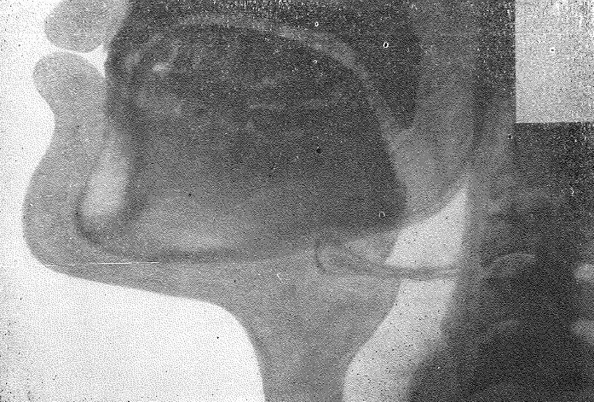
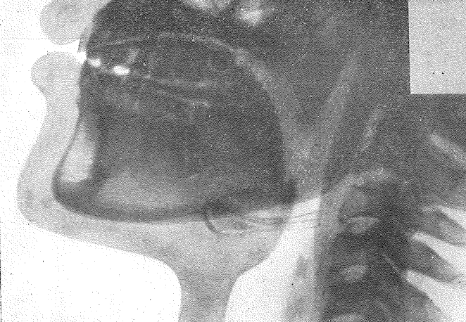
X-ray tracings for Ewen (Novikova 1960)
[-RTR] /i/
[+RTR] /ɪ/
Images courtesy of Seongyeon Ko
Notes:
These are X-ray tracings of Ewen in Novikova (1960). Compare these two vowels paying special attention to the position of the TR and the overall size of the pharyngeal cavity. You‘ll see that, compared to the non-RTR /i/, the RTR /i/ is produced with more retracted tongue root & smaller pharyngeal cavity?

Slide 7
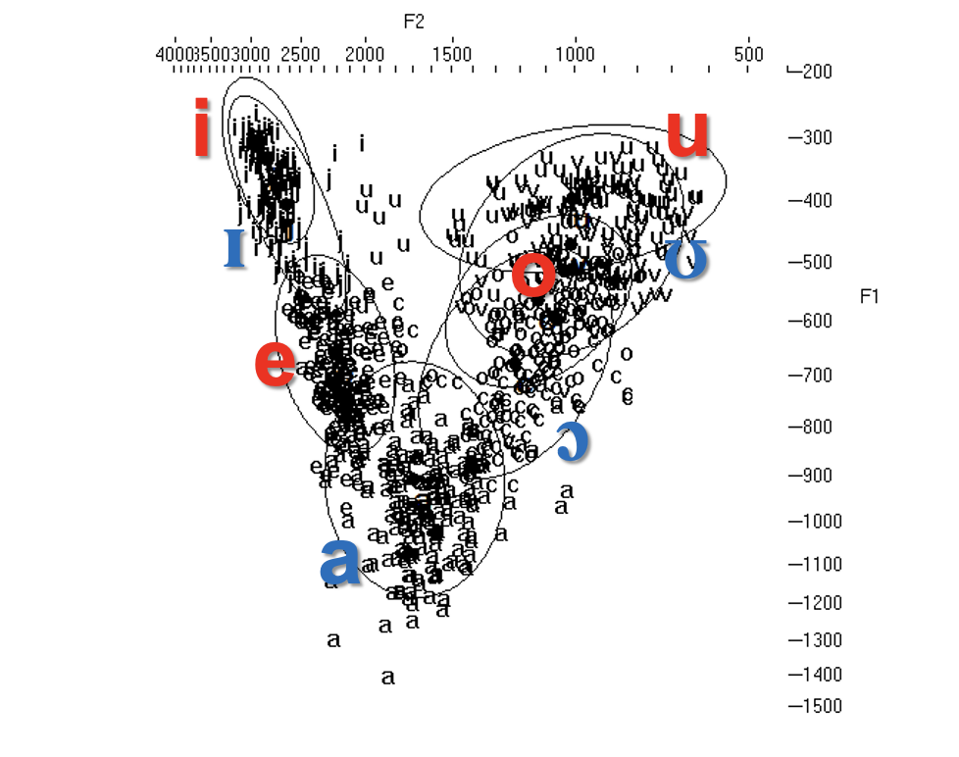
Ewen Vowel Space
Data and analysis by Seongyeon Ko

Slide 8
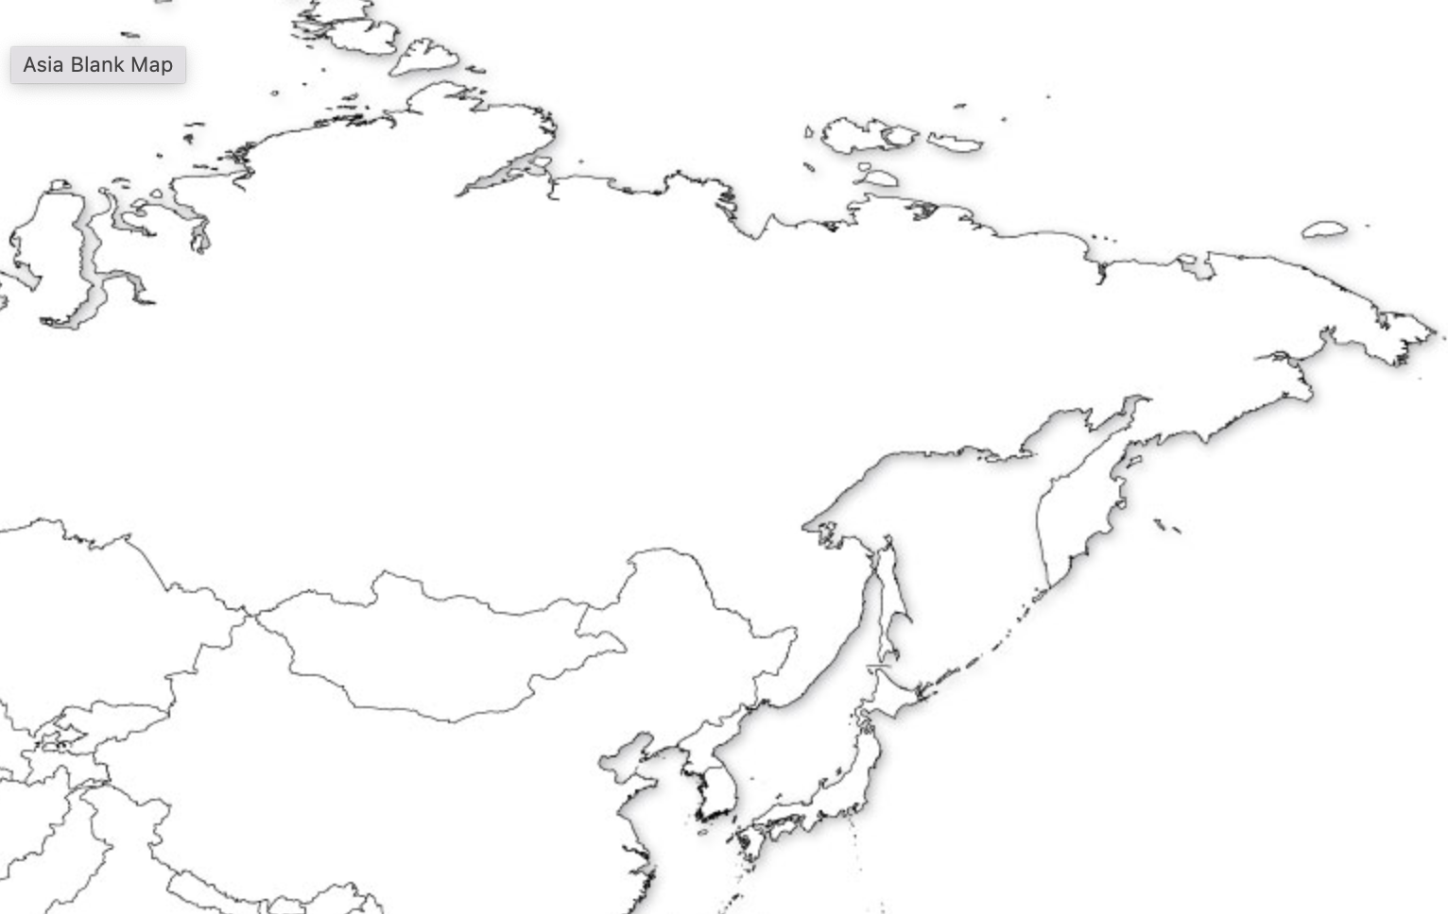
Vowel Harmony Types in Northeast Asia
Palatal Harmony
Tongue Root Harmony
Vestigial Tongue Root Harmony
Yukaghiric
Sakha
Kamchukotic
Tungusic
Amuric (Nivkh)
Kazakh
Mongolic
Kyrgyz
Uyghur
Koreanic
Japonic

Slide 9
A 6 TRH Vowel system: Nanai (So. Tungusic)
i u
e ə o
a
i, u, ə = [-RTR]
e/ɪ, o/ɔ, a = [+RTR]

Slide 10

Nanai Tongue Root Oppositions
tungdə ‘willow’
tongdo ‘straight’
i, u, ə = Advanced tongue root [-RTR]
e/ɪ, o/ɔ, a = Retracted tongue root [+RTR]
Sound files courtesy of Seongyeon Ko, recorded for Professor Juwon Kim’s Research on Endangered Altaic Languages project.

Slide 11
2. Vestigial Tongue Root Harmony Systems
Khalkha/Halh (Eastern Mongolic)
Neutral i
Set A ə u o [-RTR]
Set B a ʊ ɔ [+RTR]
(Svantesson 1985; Svantesson et al. 2005)
Late Middle Korean (Kim 1993, Ko 2012, 2018)
Neutral i
Set A ə ɨ u [-RTR]
Set B a ʌ o [+RTR]
Notes:
 Modern Khalkha and  Middle Korean are also viewed as TRH languages now.

Slide 12
LMK > Modern Korean Vestigial Harmony
.
15th c. Purhuj kiph-ɨn namk-ʌn param-aj ani muj-r ssʌj
koc tjoh-ko jərɨm ha-nʌ-ni.
ModK 뿌리 깊은 나무는 바람에 아니 흔들리므로, 꽃 좋고 열매 많으니.
Ppul-i kiph-ɨn namu-nɨn param-e ani huntulim-ɨlo
kkoch choh-ko jəlme manh-ɨni.
‘Because the tree with deep roots is not swayed by
the wind it has good flowers and bears fruit.’
Notes:
 Modern Khalkha and  Middle Korean are also viewed as TRH languages now.

Slide 13
The Decay of Korean TR Harmony (Ko 2010, 2012, 2018)
.
/ʌ/ merges with /ɨ/ in noninitial syllables
ʌ > ɨ / #(C)VC___ 16th century
/ʌ/ merges with /a/ in initial syllables
ʌ > a / #(C) ___ 18th century
LMK hanʌrh > hanɨl ‘sky, heaven’ 하늘
LMK kʌzʌrh > kaɨl ‘autumn’ 가을
Notes:
 Modern Khalkha and  Middle Korean are also viewed as TRH languages now.

Slide 14
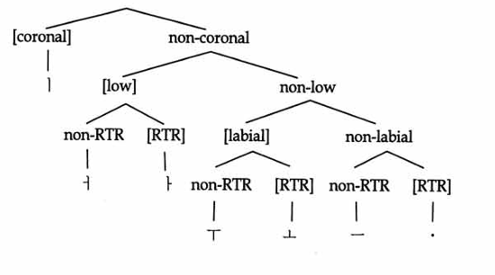
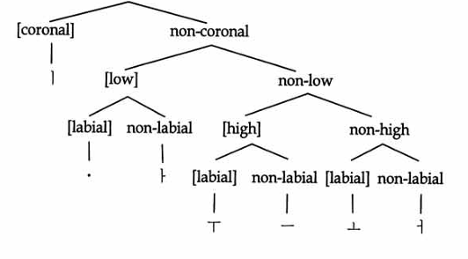
The Decay of Korean TR Harmony as Change in Contrastive Hierarchy (Ko 2010, 2012, 2018)
.
LMK Contrastive Feature Hierarchy
EModK CFH
Ko 2010: 96
Ko 2010: 104
Notes:
 Modern Khalkha and  Middle Korean are also viewed as TRH languages now.

Slide 15
The Decay of Korean TR Harmony (Ko 2012, 2018)
.
Under Ko’s Contrastive Feature Hierarchy account, loss of the [±RTR] contrast proceeds on the principle that features on the bottom of the Contrastive Hierarchy are lost first.
This may account for why Tongue Root harmony is easily lost (and acquired). While [±back] (and potentially other harmonizing features such as [±nasal] typically play a role elsewhere in the phonology, and thus are likely to be higher ranked, the role of [±RTR] tends to be restricted to vowel harmony.
Notes:
 Modern Khalkha and  Middle Korean are also viewed as TRH languages now.

Slide 16
The proto-Amuric (Nivkh) Vowel Inventory
pAmuric vowel inventory (Gruzdeva 2015)
*i *u
*e *ə *o
*a
i, u, ə = 前方舌根性 Advanced tongue root [-RTR]
e, o, a = 後方舌根性 Retracted tongue root [+RTR]

Slide 17
Nivkh affixal harmony
ñi-řlə 1s-sky ‘my sky’
ñe-řla 1s-harpoon ‘my harpoon’
ț‘i-řlə 2s-sky ‘your sky’
ț‘e-řla 2s-harpoon ‘your harpoon’
ji-řlə 3s-sky ‘his sky’
je-řla 3s-harpoon ‘his harpoon’
p‘i-řlə refl-sky ‘self’s sky’
p‘e-řla refl-harpoon ‘self’s harpoon’
(Gruzdeva 2015)

Slide 18
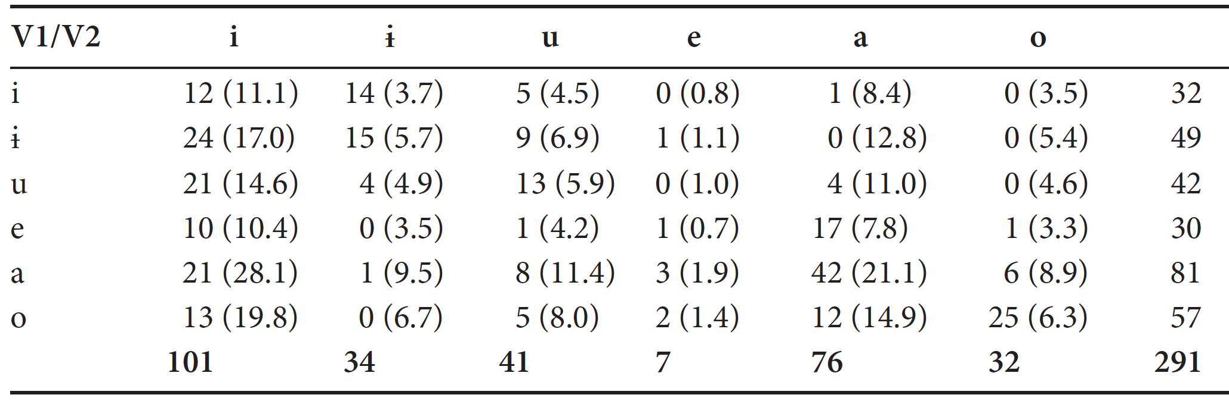
Contemporary Nivkh Vowel Inventory
Nivkh vowel inventory (Shiraishi & Botma 2017)
i ɨ u [+High]
e o
a
Shiraishi & Botma 2017: Observed and expected frequencies
[-High]

Slide 19
3. Arisaka’s Laws Arisaka Hideyo (1932)・ Ikegami Teizō’s (1932) OJ “Laws of Syllable Combination”
1. /ə/ and /o/ do not occur inside the same stem.
*ə … o
2. /ə/ and /u/ occur inside the same stem only rarely.
*ə … u
3. /ə/ and /a/ occur inside the same stem only rarely.
*ə … a

Slide 20
Arisaka’s Laws 有坂秀世・ 池上禎造の「音節結合の法則」
第一則 甲類のオ列音と乙類のオ列音とは、同一結合單位内に共存することが無い。 *ə … o
第二則 ウ列音と乙類の音とは、同一結合単位内に共存することが少い。就中ウ列音とオ列音とから成る二音節の結合單位に於て、そのオ列音は乙類のものではあり得ない。 *ə … u
第三則 ア列音と乙類のオ列音とは、同一結合單位内に共存することが少い。 *ə … a

Slide 21
Publication・Research History
Arisaka, Hideyo 有坂秀世. 1932.11. 「古事記に於けるモの仮名の用法に付いて」 『國語と國文学』 9.11.
Ikegami, Teizo 池上禎造. 1932.10. 」「古事記に於ける仮名『毛・母』に就いて」 『國語と國文学』 9.10.
Arisaka, Hideyo 有坂秀世. 1934.「古代日本語に於ける音節結合の法則」. 『國語と國文學,』 4.3.

Slide 22
The Old Japanese Vowel Inventory (Arisaka 1955, Hattori 1982, Miyake 2003, Hayata 2006)
[coronal] [labial]
i u [high]?
e ə o
a [low]?
Diphthongs uj (or wi)
ej

Slide 23
Arisaka’s view on what the “laws” meant
“I pointed out in my undergraduate thesis that the laws of syllable combination in Nara period Japanese are probably the vestiges of so-called ‘vowel harmony’… But what were the OJ rules of vowel harmony?”
/a/, /u/, and /o/ were male/yang (陽性) vowels.
/ə/ was a female/yin (陰性) vowel.
The ancestor of /i/ was neutral.
“Based on vowel harmony in other languages, we would expect that /e/ was either neutral or female/yin, but based on its actual distribution in Nara period sources, it appears only in male/yang contexts.” (1934)

Slide 24
Arisaka’s view on what the “laws” meant
奈良時代の國語に於ける音節結合の法則が、いはゆる母音調和の法則の名残なるべきことについては、既に卒業論文の中に述べておいた…さてもしさうとすれば、古代國語に存在した母音調和の法則は果してどんなものであったらうか。まづア列音（a)ウ列音（u）及び甲類のオ列音（o）に對應する古代母音が陽性、乙類のオ列音）に對應する古代母音が陰性であったことはいふまでもない。甲類のイ列音（i）の祖先が中世であったことも間違ひは無からう。甲類のエ列音（e）の祖先も、他國語の母音調和の例から推すならば、中性又は陰性でありさうに期待されるが、奈良時代の文献にあらはれた所では、甲類のエ列音は實際のところ陽性相當の場所にしかあらはれて來ないのである。 (1934)

Slide 25
Old Japanese (8th century) syllabic nuclei with representative phonograms
OJ value MC value of selected ongana
1. /a/ [a] 阿 /ɑ/、安 /ɑn/
2. /i/ [i]（甲類i、i₁） 企 /kʰiɛ^{H}/、比 / piɪ^{X}/
3. /uj/ [ʉj]（乙類i、i₂） 貴 /kʉi^{H}/、非 /pʉi/
4. /u/ [u] 宇 /ɦɨo^{X}/、烏 /ʔuo/
5. /e/ [e]（甲類e、e₁） 弁 /bˠiɛn^{H}/、売 /mˠɛ^{H}/
6. /ej/ [ej]（乙類e、e₂） 閉 /pei^{H}/、米 /mei^{X}/
7. /o/ [o]（甲類o、o₁） 古 /kuo^{X}/、毛 /mɑu/
8. /ə/ [ə]（乙類o、o ₂） 己 /kɨ^{X}/、 母 /məu^{X}/

Slide 26
Two processes in progress in the 8th century
Merger of /ə/ with /o/ after labial consonants
ə > o / [+labial] ___
This was generalized to all contexts by mid-9th century.
Mid vowel Raising
e > i, o > u/ ___ (nonfinal)
EMJ kogane ‘gold’ : WOJ kugane < ku- ‘yellow’ + kane ‘metal’
EOJ sugos- ‘surpass’ : WOJ sugus < *sugo- ‘exceed’+ -s- transitive

Slide 27
4. OJ Vowel Alternations as Tongue Root Harmony
Hayata 2006
Harmonic opposition based on a 6V system for pJR
i ə u (女性母音)
e a o (男性母音)
Harmonic opposition for pre-Qing Manchu
i ə u (女性母音)
e a o (男性母音)

Slide 28
Harmonic oppositions in noun inflection (Hayata 2006)
Genitive suffix -nə/-na after bound nouns
木の kə nə 月の tuku nə (EOJ) 火の pə nə
tree-gen moon-gen fire-gen
手な ta na 目な ma na 水な mi na < *me
hand-gen moon-gen fire-gen
Amami-Yamatohama mɨdzɨ ‘water’, midzo ‘ditch’ (Hattori 1976, Amami-Yamatohama data from Pellard 2018)

Slide 29
Harmonic oppositions in verb inflection (Hayata 2006)
Subject honorific suffix -s-
伎許志弖 kik-əs-ite 於毛保世 əməp-əs-e
hear-hon… think-hon…
多多勢禮婆 tat-as-ereba 斗波佐泥 twop-as-an- stand-hon… ask-hon…

Slide 30
Harmonic oppositions in verbal derivation
Durative suffix -Vp-
宇都呂比 utur-əp-i 富己呂倍騰 pəkər-əp-edo
change-dur-inf think-dur-advers
麻毛良比 mamor-ap-i 加波良比 kapar-ap-i watch.over-dur-inf change-dur-inf

Slide 31
4. The OJ system as (Retracted) Tongue Root Harmony (Whitman 2016)
Harmonic opposition based on a 6V system for pJR
i ə u [-RTR]
e a o [+RTR]
Harmonic opposition for Nanai
i ə u [-RTR]
e/ɪ a o/ɔ [+RTR]

Slide 32
Returning to the OJ Vowel Inventory
[coronal] [labial]
i u [-RTR]
[+RTR]
e o
ə
[+low]
a
Diphthongs uj (or wi) ej

Slide 33
But there are questions
Why aren’t the OJ harmonic alternations more present in inflection? They seem to be found only in the deepest, semi-productive inflectional and derivational layer.
What’s going on with Arisaka’s 2nd law? It bans co-occurrence of /ə/ and /u/. Both are
[-RTR], so they should be able to co-occur.

Slide 34
Recall Mid Vowel Raising
As we have seen, Mid Vowel Raising (Miyake 2003, Frellesvig & Whitman 2004) merged *o with *u and *e with *i in non-initial position prior to OJ.
Proto-Ryukyuan (and EOJ) was more resistant to MVR, thus *me- for ‘water’. EMJ kogane ‘gold’ for WOJ kugane and alternation between OJ muko/muko ‘bridegroom’ reflect similar variation.
MVR would have affected any hypothetical harmonic alternation -i/-e in the infinitive suffix, since the infinitive often appears in non-initial position. It is also possible, as Arisaka suggests, that *i was neutral.

Slide 35
5. The Eastern Old Japanese Adnominal Suffix
In Eastern Old Japanese (EOJ), the attributive suffix for consonant stem verbs (-u in WOJ) appears frequently as -o (Hōjō 1966).
Some argue that -o is the regular EOJ form if we control the data for region (Ikier 2006).
Some reconstruct -o as the pJR protoform (Bentley 2012).
However Frellesvig (2012b) argues that the alteration in EOJ between -u and -o is irregular and not limited to the adnominal.

Slide 36
The Eastern Old Japanese Adnominal Suffix
Ubej kona=pa wanu=ni kop-u namo tat-o tuku=nə
of.course you=top I=dat love-adn evid rise-adn moon=gen
nuganape-yukeba kopusikaru namo
flow-go-realcon be.in.love-adn evid Man’yōshū 14.3476
‘Of course you must love me. As the moons/ months come and go, love will surely abide.’
「いかにもあなたは私に恋しているだろう。改まる月が流れて行くので、恋しいことだろう。」

Slide 37
The EOJ adnominal suffix: Data (Ikier 2006)
52 examples of adnominal -o
30 (36) involve auxiliary verbs with stem final /a/:
20 after future -am-, 5 after tentative -unam-
3 after negative -an-, 2 after progressive -ar-
6 after perfective -n- < *na-
11 involve main verbs with stem-final /a/
4 involve stem final /i/ or /u/, which may come from *e or *o by mid vowel raising.
Only 1 comes after possible stem-final /ə/, but in this example, əməp-o, the stem-final vowel, although historically *, has merged with /o/ in EOJ.

Slide 38
The EOJ adnominal suffix: Conclusion
Rather than preserving the older adnominal suffix
*-o, EOJ may preserve the original harmonic alternation
in a productive inflectional suffix.
The apparent sporadicity of the -o allomorph is in fact phonologically conditioned.
Inflectional affixes such as the adjectival suffixes -ki (adnominal), -si (conclusive ), and -ku (infinitive) may reflect aharmonism of consonant-initial suffixes, as in Late Middle Korean.
Inflectional categories such as the irrealis (mizenkei) result from rebracketing of the suffix-initial vowel (e.g. negative V–an- > V-a-n, passive V-ar/j- > V-a-r/j-).

Slide 39
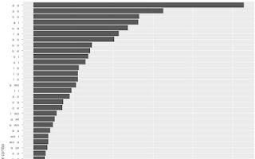
6. Arisaka’s Laws 1 and 3 as Reflexes of Tongue Root Harmony
Vowel combination frequencies in disyllables in the Oxford-NINJAL Corpus of Old Japanese (National Institute for Japanese Language and Linguistics 2020)

Slide 40
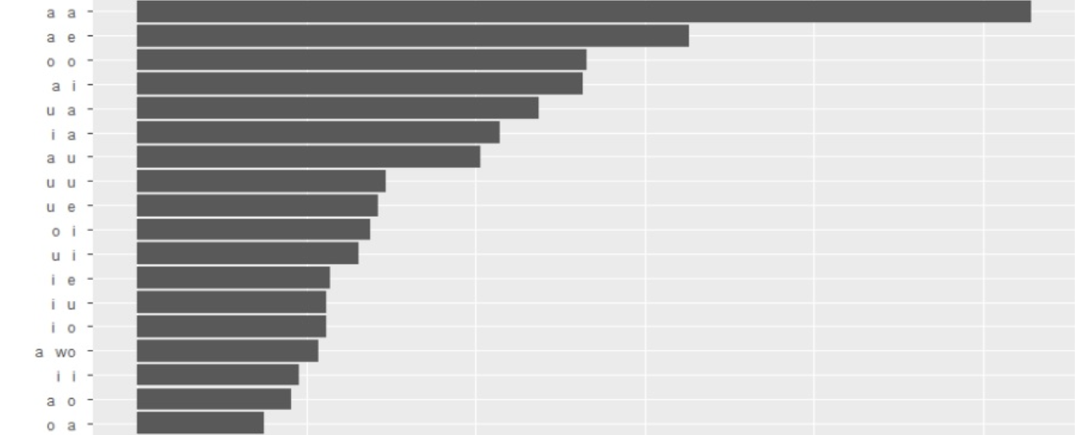

Slide 41
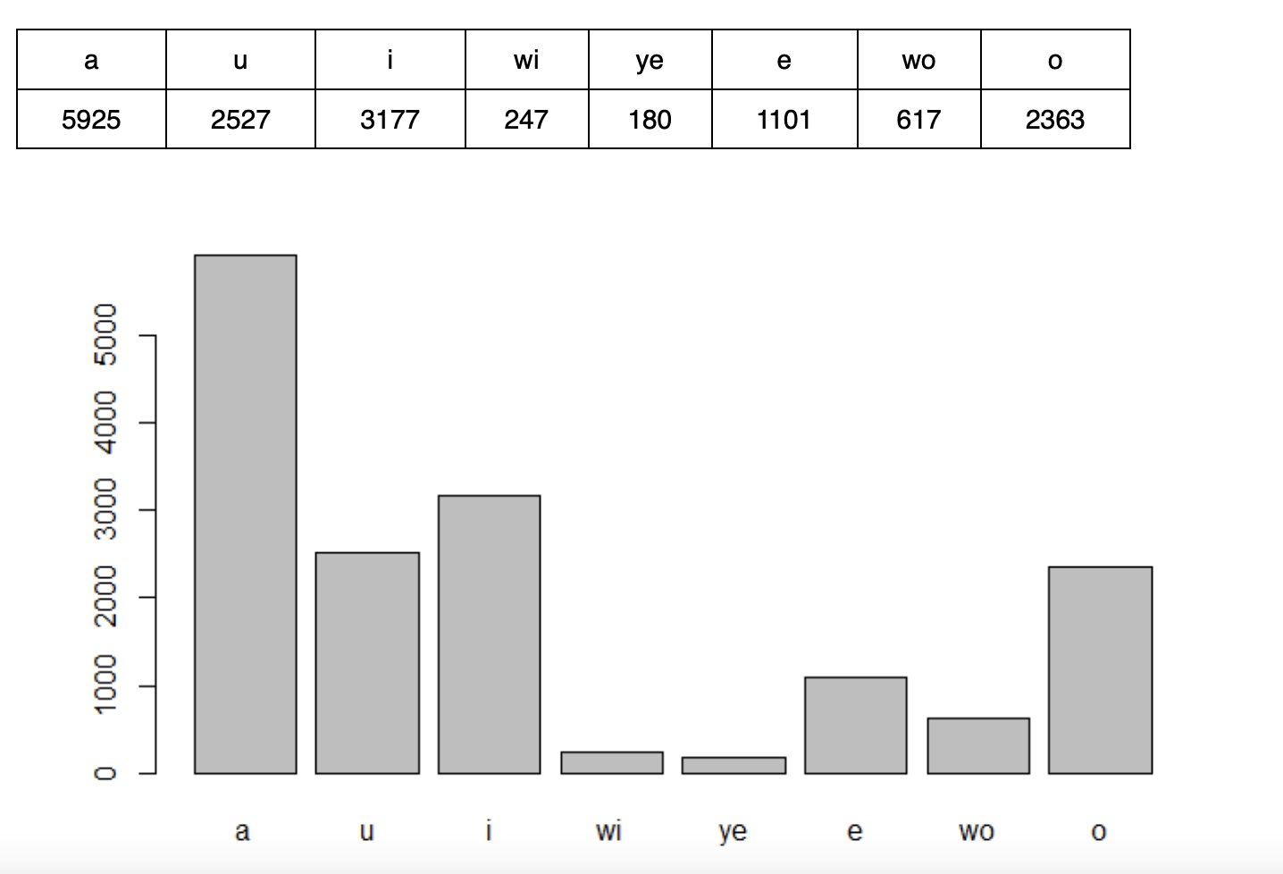
Counts of the 8 OJ vocalic nuclei in the ONCOJ
(uj)
(e)
(ej)
(o)
(ə)

Slide 42
Arisaka’s 1st Law as reflected in the ONCOJ
ə…o 3 potential counterexamples, 1 real
mə/oko ‘partner, bridegroom’ (EMJ muko)
pə/oto ‘time, interval’
Təko placename
o…ə 3 potential counterexamples, 0 real
kosə variant spelling of focus particle kəsə
torə EOJ, meaning unclear
jorə EOJ ‘evening’ (WOJ joru)

Slide 43
Arisaka’s 3rd Law as reflected in the ONCOJ
ə…a 32 potential counterexamples.
A significant number are bimorphemic, e.g.
kəj-as- ‘lie.down-hon’
a…ə 38 potential counterexamples. 12 have the second vowel after a labial, where o/ə merge. Others are again bimorphemic, e.g. jadər- ‘lodge in’ < ja ‘shelter’ + =ni locative+ tor- ‘take’.

Slide 44
7. Arisaka’s 2nd law
13 examples of ə…u
12 examples of u… ə
Some of the scarcity of *[u…ə] can attributed to a proportion of OJ nonfinal /u/ originating from *o by Mid Vowel Raising.
But hardly all. And the scarcity of *[ə…u] cannot be explained this way.
There must have been a secondary co-occurrence restriction operating on rounded vowels.

Slide 45
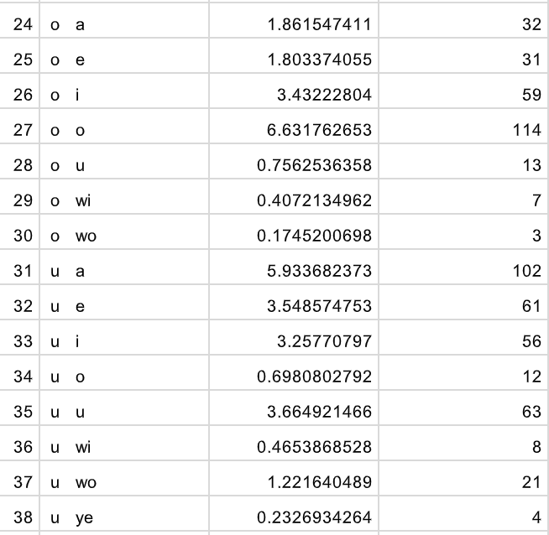

Slide 46
Arisaka’s 2nd law and Labial Attractiom
“Labial” attraction is the traditional term used for both stem-internal and suffixal labial harmony in Turkic, Mongolic, and Tungusic (Vaux 1993)
None of the vestigial TR harmony languages discussed here give evidence for labial harmony.
But Dresher & Nevins (2017) argue that stem-internal and suffixal labial harmony must be distinguished in Oroqen (Tungusic); the former is a morpheme structure condition.
A version of stem-internal labial attraction may have restricted co-occurrence of /u/ and /ə/.

Slide 47
9. Conclusions
A residual TR harmony analysis fits the shape of the OJ vowel system best.
An RTR-type alternation can be seen in deeply embedded derivational alternations.
An RTR-conditioned alternation may be visible in the EOJ adnominal alternation between -o and -u.
Stem internally, the RTR VH hypothesis accounts for Arisaka’s 1st and 3rd laws.
Arisaka’s 2nd law suggests a co-occurrence restriction similar to so-called labial attraction in Turkic, Mongolic and Tungusic, restricting *u and *o in the same stem.

Slide 48
Selected References
Bentley, John.2012. Old Japanese. In Tranter, Nicolas (ed.). The Languages of Japan and Korea. Routledge. pp. 189–211.
Frellesvig, Bjarke 2012a. A History of the Japanese Language.
Frellesvig, Bjarke 2012b Chronological layering in proto-Japanese and pre-Old Japanese verb inflection.
Hattori, Shiro. 1976. Jо̄dai nihongo no boin taikei to boin chо̄wa [The vowel system of Old Japanese and vowel harmony]’, Gekkan gengo 5(6): 2–14.
Hattori, Shiro. 1982. Vowel harmonies of the Altaic languages, Korean, and Japanese, Acta Orientalia Hungarica 36: 207–214.
Hayata, Teruhiro (1980). ‘Non-Abstract Vowel Harmony in Manchu’, Gengo Kenkyu [Journal of the Linguistic Society of Japan] 77: 59–79.
Hayata, Teruhiro (2006). ‘Jōdai Nihongo boin chōwa obegaki [Thoughts on vowel harmony in Old Japanese]’, Chikusi gogaku ronsō II: Nihongoshi to hōgen. Tokyo: Kazama shobō, 1–16.
北条忠雄. 1966. 上代東国方言の研究. 東京: 日本学術振興会. 出版
Ikier, Steven. 2006. On the attributive and final predicate forms in Eastern Old Japanese. MA thesis, University of Hawai‘i.

Slide 49
Selected References (continued)
Kim, Juwon 1988. Moŭm cohwa wa sŏlchwuk.
Ko, Seongyeon. 2018. Tongue Root Harmony and Vowel Contrast in Northeast Asian Languages.
Ko, Seongyeon, Joseph, Andrew, and John Whitman 2014. Comparative consequence of the tongue root harmony analysis of proto-Tungusic, Proto-Mongolic, and Proto-Korean.
Miyake, Marc. 2003. Philological evidence for *e and *o in Pre-Old Japanese. Diachronica 20:81-136.
National Institute for Japanese Language and Linguistics. 2020. Oxford-NINJAL Corpus of Old Japanese. http://oncoj.ninjal.ac.jp/ (accessed 9 March 2023).
Pellard, Thomas 2013. Ryūkyūan perspectives on the proto-Japanese vowel system.
Pellard, Thomas 2013. Ryūkyūan and the reconstruction of proto-Japanese- Ryūkyūan.

Slide 50
Selected References (continued)
Vaux, Bert. 1993. The origins of labial attraction. Harvard Working Papers in Linguistics 2, 228–237.
Whitman, John 2016. Nichiryū sogo no on’in taikei to rentaikei, izenkei no kigen.

